Slide 1
Can We Determine Whether an Email is SPAM?
Xinyue Liu

Slide 2
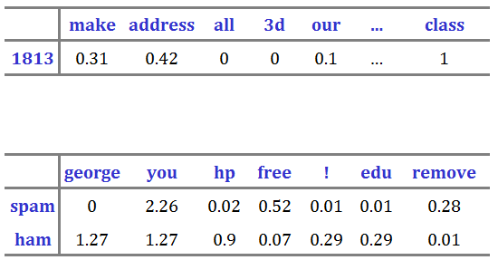
The Spambase Data Set
Goal: classify spam from ham based on the frequencies of words in the email.
Source and Origin
Goal
Instances and Attributes
Examples
Tool

Slide 3
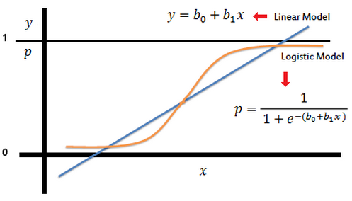
Logistic Regression
Linear Regression: Assign weights to each of the predictors which minimize the classification error
Logistic regression

Slide 4
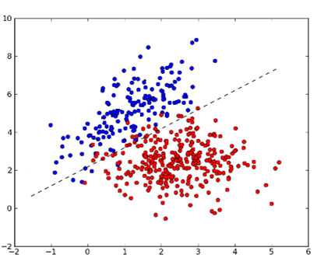
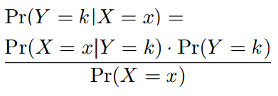
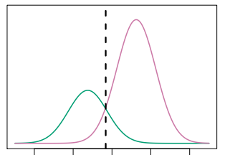
Linear Discriminant Analysis (LDA)
Bayes Theorem:

Slide 5
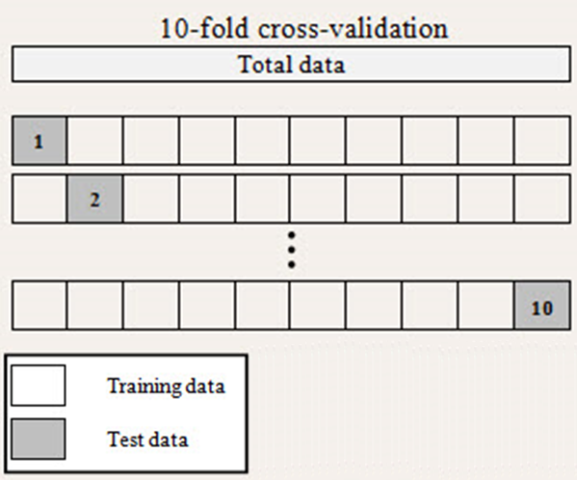
10-fold Cross-Validation

Slide 6
Conclusion
Logistic Regression
Linear Discriminant Analysis (LDA)
Mean Error Rate with 96% CI:
10.6% – 11.1%
Mean Error Rate with 96% CI:
9.9% – 10.5%
We can filter about 90% of spam emails using LDA.

Slide 7
References
Trevor Hastie, Rob Tibshirani. “Statistical Learning.” Statistical Learning. Stanford University Online CourseWare, 21 January 2014. Lecture. <http://online.stanford.edu/course/statistical-learning-winter-2014 >
Mark Hopkins, Erik Reeber, George Forman, and Jaap Suermondt. "Spambase Data Set." Spambase Data Set. Hewlett-Packard Labs, 1 July 1999. Web. 1 Mar. 2015. <http://archive.ics.uci.edu/ml/datasets/Spambase>.
"Logistic Regression." Logistic Regression. N.p., n.d. Web. 5 May 2015. <http://www.saedsayad.com/logistic_regression.htm>.
"Binary Classification." Linear Discriminant Analysis Classifier (LDAC). N.p., n.d. Web. 5 May 2015. <http://mlpy.sourceforge.net/docs/3.5/lin_class.html>.
Kaewchinporn, Chinnapat. "10-fold Cross-Validation." K-fold Cross-validation. N.p., n.d. Web. 5 May 2015. <http://scriptslines.com/blog/k-fold-cross-validation/>.

Slide 8
Thank you!

